Slide 1
Module – 9 Introduction to Business continuity
1
Notes:
Module – 9
Introduction to Business Continuity
Module 9: Introduction to Business Continuity

Slide 2
Module 9: Introduction to Business Continuity
Upon completion of this module, you should be able to:
Define business continuity (BC) and information availability (IA)
Explain the impact of information unavailability
Describe BC planning process
Explain business impact analysis (BIA)
Explain BC technology solutions
Notes:
Module 9: Introduction to Business Continuity

Slide 3
Module 9: Introduction to Business Continuity
Lesson 1: Business Continuity Overview
During this lesson the following topics are covered:
Business continuity
Information availability metrics
Notes:
Module 9: Introduction to Business Continuity

Slide 4
Why Business Continuity?
Information is an organization’s most important asset
Continuous access to information ensures smooth functioning of business operations
Cost of unavailability of information to an organization is greater than ever
Notes:
Module 9: Introduction to Business Continuity

Slide 5
What is Business Continuity?
Business Continuity
It is a process that prepares for, responds to, and recovers from a system outage that can adversely affects business operations.
An integrated and enterprise-wide process that includes set of activities to ensure “information availability”
BC involves proactive measures and reactive countermeasures
In a virtualized environment, BC solutions need to protect both physical and virtualized resources
Notes:
Module 9: Introduction to Business Continuity

Slide 6
Information Availability
Information Availability
It is the ability of an IT infrastructure to function according to business expectations, during its specified time of operation.
Information availability can be defined with the help of:
Accessibility
Information should be accessible to the right user when required
Reliability
Information should be reliable and correct in all aspects
Notes:
Module 9: Introduction to Business Continuity

Slide 7
Information Availability
Information Availability
It is the ability of an IT infrastructure to function according to business expectations, during its specified time of operation.
Information availability can be defined with the help of:
Timeliness
Defines the time window during which information must be accessible
For example, if online access to an application is required between 8:00 am and 10:00 pm each day, any disruptions to data availability outside of this time slot are not considered to affect timeliness.
Notes:
Module 9: Introduction to Business Continuity

Slide 8
Causes of Information Unavailability
Disaster (<1% of Occurrences)
Natural or man made
Flood
Fire
Earthquake
Unplanned Outages (20%)
Failure
Database corruption
Component (physical and/or virtual) failure
Human error
Planned Outages (80%)
Competing workloads
Backup, reporting
Data warehouse extracts
Application and data restore
Notes:
Module 9: Introduction to Business Continuity

Slide 9

Impact of Downtime
Lost Productivity
Know the downtime costs (per hour, day, two days, and so on.)
Lost Revenue
Number of employees impacted x hours out x hourly rate
Direct loss
Compensatory payments
Lost future revenue
Billing losses
Investment losses
Damaged Reputation
Financial Performance
Customers
Suppliers
Financial markets
Banks
Business partners
Revenue recognition
Cash flow
Lost discounts (A/P)
Payment guarantees
Credit rating
Stock price
Other Expenses
Temporary employees, equipment rental, overtime costs, extra shipping costs, travel expenses, and so on.
Notes:
Module 9: Introduction to Business Continuity

Slide 10
Impact of Downtime
The business impact of downtime is the sum of all losses sustained as a result of a given disruption
Average cost of downtime per hour
provides a key estimate in determining the appropriate BC solutions
may also include estimates of projected revenue loss due to other consequences, such as damaged reputations, and the additional cost of repairing the system
average productivity loss per hour + average revenue loss per hour
Notes:
Module 9: Introduction to Business Continuity

Slide 11
Impact of Downtime
Productivity loss per hour
(total salaries and benefits of all employees per week) / (average number of working hours per week)
Average revenue loss per hour
(total revenue of an organization per week) / (average number of hours per week that an organization is open for business)
Notes:
Module 9: Introduction to Business Continuity

Slide 12
Measuring Information Availability
Time to repair or ‘downtime’
Response Time
Recovery Time
Detection
Repair
Restoration
Incident
Incident
Diagnosis
Recovery
Time
Detection elapsed time
Repair time
Time between failures or ‘uptime’
Mean Time Between Failure/MTBF: Average time available for a system or component to perform its normal operations between failures
MTBF = Total uptime/Number of failures
Mean Time To Repair/MTTR: Average time required to repair a failed component
MTTR = Total downtime/Number of failures
Notes:
Module 9: Introduction to Business Continuity

Slide 13
Measuring Information Availability
Time to repair or ‘downtime’
Response Time
Recovery Time
Detection
Repair
Restoration
Incident
Incident
Diagnosis
Recovery
Time
Detection elapsed time
Repair time
Time between failures or ‘uptime’
Information Availability/IA
IA = MTBF/(MTBF + MTTR)
IA = uptime/(uptime + downtime)
Notes:
Module 9: Introduction to Business Continuity

Slide 14
Availability Measurement – Levels of ‘9s’ Availability
Uptime (%) | Downtime (%) | Downtime per Year | Downtime per Week
98 | 2 | 7.3 days | 3hrs, 22 minutes
99 | 1 | 3.65 days | 1 hr, 41 minutes
99.8 | 0.2 | 17 hrs, 31 minutes | 20 minutes, 10 secs
99.9 | 0.1 | 8 hrs, 45 minutes | 10 minutes, 5 secs
99.99 | 0.01 | 52.5 minutes | 1 minute
99.999 | 0.001 | 5.25 minutes | 6 secs
99.9999 | 0.0001 | 31.5 secs | 0.6 secs
Notes:
Module 9: Introduction to Business Continuity

Slide 15
Module 9: Introduction to Business Continuity
Lesson 2: BC Planning and Technology Solutions
During this lesson the following topics are covered:
BC terminologies
BC planning
Business impact analysis
Single points of failure
Multipathing software
Notes:
Module 9: Introduction to Business Continuity

Slide 16
BC Terminologies – 1
Disaster recovery
Coordinated process of restoring systems, data, and infrastructure required to support business operations after a disaster occurs
Restoring previous copy of data and applying logs to that copy to bring it to a known point of consistency
Generally implies use of backup technology
Disaster restart
Process of restarting business operations with mirrored consistent copies of data and applications
Generally implies use of replication technologies
Notes:
Module 9: Introduction to Business Continuity

Slide 17
BC Terminologies – 2
Recovery-Point Objective (RPO)
Point-in-time to which systems and data must be recovered after an outage
Amount of data loss that a business can endure
Recovery-Time Objective (RTO)
Time within which systems and applications must be recovered after an outage
Amount of downtime that a business can endure and survive
Weeks
Tape Backup
Weeks
Tape Restore
Days
Days
Disk Restore
Periodic Replication
Hours
Hours
Asynchronous Replication
Manual Migration
Minutes
Minutes
Seconds
Synchronous Replication
Seconds
Global Cluster
Recovery-point objective
Recovery-time objective
Notes:
Module 9: Introduction to Business Continuity

Slide 18
Recovery-Point Objective (RPO)
RPO of 24 hours
Backups are created at an offsite tape library every midnight. The corresponding recovery strategy is to restore data from the set of last backup tapes.
RPO of 1 hour
Shipping database logs to the remote site every hour. The corresponding recovery strategy is to recover the database to the point of the last log shipment.
RPO in the order of minutes
Mirroring data asynchronously to a remote site.
RPO of zero
Mirroring data synchronously to a remote site.
Notes:
Module 9: Introduction to Business Continuity

Slide 19
Recovery-Time Objective (RTO)
RTO of 72 hours
Restore from tapes available at a cold site.
RTO of 12 hours
Restore from tapes available at a hot site.
RTO of few hours
Use disk-based backup technology, which gives faster restore than a tape backup.
RTO of a few seconds
Cluster production servers with bidirectional mirroring, enabling the applications to run at both sites simultaneously.
Notes:
Module 9: Introduction to Business Continuity

Slide 20
BC Planning Lifecycle
Establishing Objectives
Analyzing
Designing and Developing
Implementing
Training, Testing, Assessing, and Maintaining
Notes:
Module 9: Introduction to Business Continuity

Slide 21
BC Planning Lifecycle
Establishing objectives
Determine BC requirements.
Estimate the scope and budget to achieve requirements.
Select a BC team that includes subject matter experts from all areas of the business, whether internal or external.
Create BC policies.
Notes:
Module 9: Introduction to Business Continuity

Slide 22
BC Planning Lifecycle
Analyzing
Collect information on data profiles, business processes, infrastructure support, dependencies, and frequency of using business infrastructure.
Conduct a business impact analysis.
Identify critical business processes and assign recovery priorities.
Perform risk analysis for critical functions and create mitigation strategies.
Perform cost benefit analysis for available solutions based on the mitigation strategy.
Evaluate options.
Notes:
Module 9: Introduction to Business Continuity

Slide 23
BC Planning Lifecycle
Designing and developing
Define the team structure and assign individual roles and responsibilities.
For example, different teams are formed for activities, such as emergency response, and infrastructure and application recovery.
Design data protection strategies and develop infrastructure.
Develop contingency solution and emergency response procedures.
Detail recovery and restart procedures.
Notes:
Module 9: Introduction to Business Continuity

Slide 24
BC Planning Lifecycle
Implementing
Implement risk management and mitigation procedures that include backup, replication, and management of resources.
Prepare the DR sites that can be utilized if a disaster affects the primary data center.
Implement redundancy for every resource in a data center to avoid single points of failure.
Notes:
Module 9: Introduction to Business Continuity

Slide 25
BC Planning Lifecycle
Training, testing, assessing, and maintaining
Train the employees who are responsible for backup and replication of business-critical data on a regular basis or whenever there is a modification in the BC plan.
Train employees on emergency response procedures when disasters are declared.
Train the recovery team on recovery procedures based on contingency scenarios.
Perform damage-assessment processes and review recovery plans.
Notes:
Module 9: Introduction to Business Continuity

Slide 26
BC Planning Lifecycle
Training, testing, assessing, and maintaining
Test the BC plan regularly to evaluate its performance and identify its limitations.
Assess the performance reports and identify limitations.
Update the BC plans and recovery/restart procedures to reflect regular changes within the data center.
Notes:
Module 9: Introduction to Business Continuity

Slide 27
Business Impact Analysis
Identifies which business units and processes are essential to the survival of the business
Estimates the cost of failure for each business process
Calculates the maximum tolerable outage and defines RTO for each business process
Businesses can prioritize and implement countermeasures to mitigate the likelihood of such disruptions
Notes:
Module 9: Introduction to Business Continuity

Slide 28
Business Impact Analysis
A BIA includes the following set of tasks:
Determine the business areas.
For each business area, identify the key business processes critical to its operation.
Determine the attributes of the business process in terms of applications, databases, and hardware and software requirements.
Estimate the costs of failure for each business process.
Calculate the maximum tolerable outage and define RTO for each business process.
Notes:
Module 9: Introduction to Business Continuity

Slide 29
Business Impact Analysis
A BIA includes the following set of tasks:
Establish the minimum resources required for the operation of business processes.
Determine recovery strategies and the cost for implementing them.
Optimize the backup and business recovery strategy based on business priorities.
Analyze the current state of BC readiness and optimize future BC planning.
Notes:
Module 9: Introduction to Business Continuity

Slide 30
BC Technology Solutions
Solutions that enable BC are:
Resolving single points of failure
Multipathing software
Backup and replication
Backup
Local replication
Remote replication
Notes:
Module 9: Introduction to Business Continuity

Slide 31
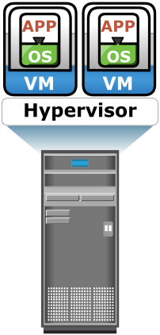
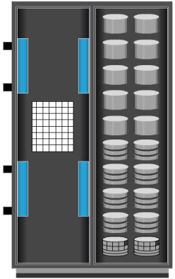

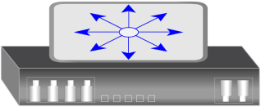
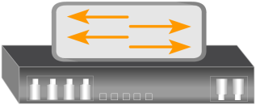
Single Points of Failure
Single Points of Failure
It refers to the failure of a component of a system that can terminate the availability of the entire system or IT service.
Array port
Client
IP Switch
FC Switch
Server
Storage Array
Notes:
Module 9: Introduction to Business Continuity

Slide 32
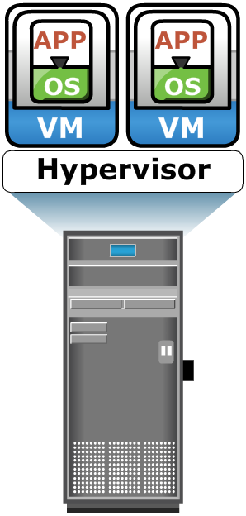
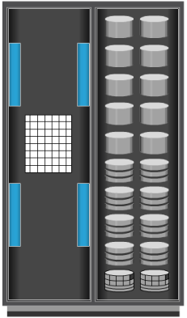

Resolving Single Points of Failure
Redundant Arrays
Client
Redundant Paths
Redundant Ports
NIC
HBA
NIC
HBA
IP
Redundant Network
Redundant FC Switches
NIC
HBA
Production Storage Array
Remote Storage Array
NIC Teaming
NIC
HBA
Clustered Servers
Notes:
Module 9: Introduction to Business Continuity

Slide 33
Multipathing Software
Recognizes and utilizes alternate I/O path to data
Provides load balancing by distributing I/Os to all available, active paths:
Improves I/O performance and data path utilization
Intelligently manages the paths to a device by sending I/O down the optimal path:
Based on the load balancing and failover policy setting for the device
Notes:
Module 9: Introduction to Business Continuity

Slide 34
Module 9: Introduction to Business Continuity
Concept in Practice
EMC PowerPath
Notes:
Module 9: Introduction to Business Continuity

Slide 35


EMC PowerPath
Host Application
Host-based multipathing software
Provides path failover and load-balancing functionality
Automatic detection and recovery from host-to-array path failures
PowerPath/VE software allows optimizing virtual environments with PowerPath multipathing features
PowerPath
HOST
HBA Driver
HBA Driver
HBA Driver
HBA Driver
HBA
HBA
HBA
HBA
Storage Network
STORAGE
LUNs
35
Notes:
Module 9: Introduction to Business Continuity

Slide 36
Module 9: Summary
Importance of business continuity
Impact of information unavailability
Information availability metrics
Business impact analysis
Single points of failure
Multipathing software
Notes:
Module 9: Introduction to Business Continuity

Slide 37
Exercise 1: MTBF and MTTR
A system has three components and requires all three to be operational for 24 hours from Monday to Friday. Failure of component 1 occurs as follows:
Monday = No failure
Tuesday = 5 am to 7 am
Wednesday = No failure
Thursday = 4 pm to 8 pm
Friday = 8 am to 11 am
Calculate the MTBF and MTTR of component 1.
Notes:
Module 9: Introduction to Business Continuity

Slide 38
Exercise 2: Information Availability
A system has three components and requires all three to be operational from 8 am to 5 pm business hours, Monday to Friday. Failure of component 2 occurs as follows:
Monday = 8 am to 11 am
Tuesday = No failure
Wednesday = 4 pm to 7 pm
Thursday = 5 pm to 8 pm
Friday = 1 pm to 2 pm
Calculate the availability of component 2.
Notes:
Module 9: Introduction to Business Continuity

